Slide 1
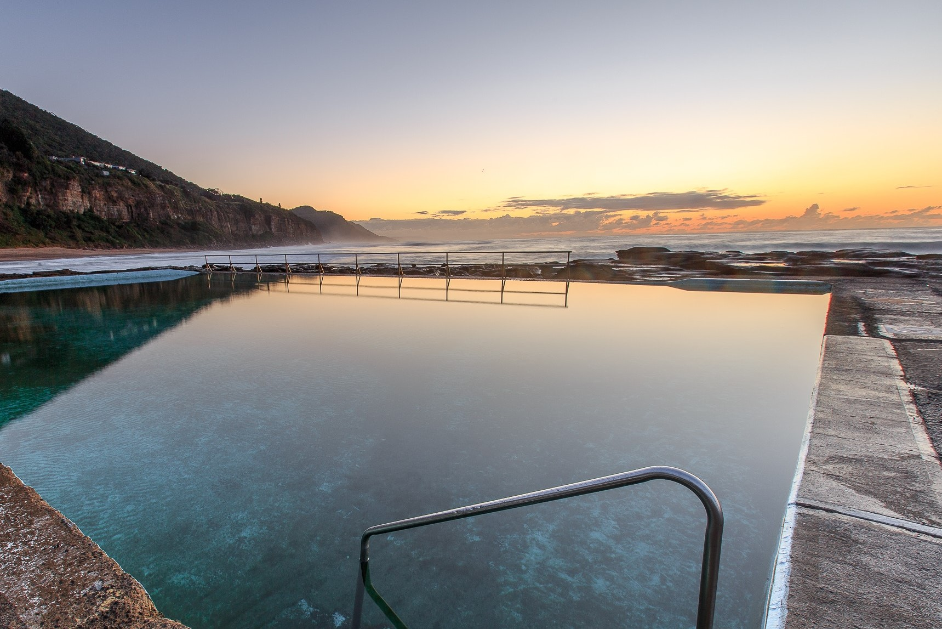
Projet Piscine Ing3 PloufBook
Quentin Aré
Solène Consten
Martin Le Mintier

Slide 2

Sommaire

Slide 3
Conception du Back

Slide 4






Design du Front
JP Segadeau
Auteur
Fil d’actualité
Blablabla
Qui etes-vous ?
Mail
Pseudo
Connexion
Administrateur
Ajouter
Bouton
Supprimer
TextField
ComboBox

Slide 5


Design du Front
Vous
Si on clique sur publier
JP Segadeau
Publier
Publier
Entrez votre texte
Publier

Slide 6




Design du Front
Emplois
Offres d’emplois
Professeur Web
Stagiaire
Notifications
JP a liké votre photo
JP a pas aimé votre photo
JP a répondu à votre commentaire

Slide 7
Design du Front
Méssagerie
Messages
Liste d’amis
Mon Réseau
Entrez votre texte
Mes Relations
JP Segadeau
JP Segadeau
JP Segadeau

Slide 8
Spécifications Fonctionnelles

Slide 9
Versionning GIT

Slide 10
Bilans

Slide 11
Sources

Slide 12
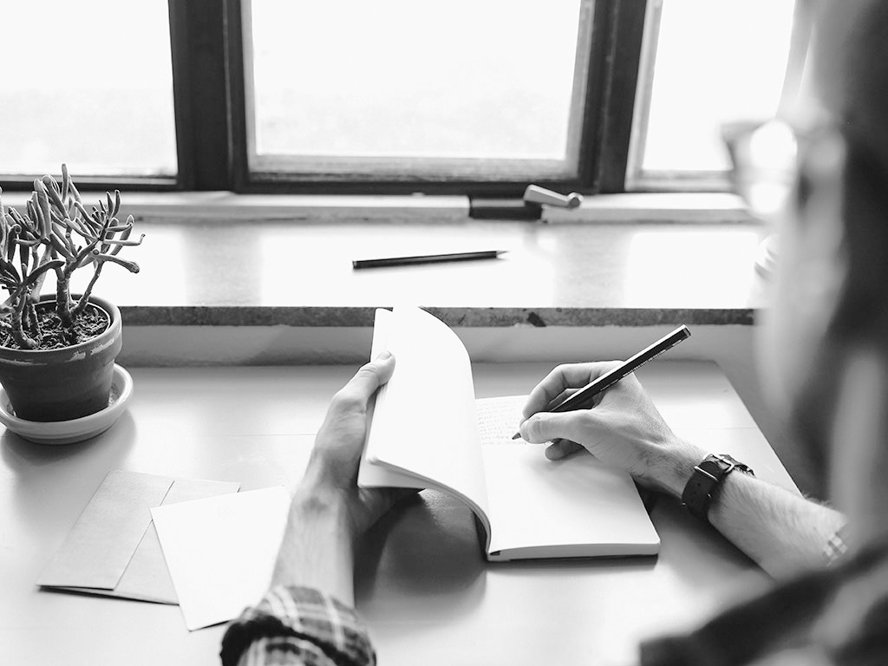
Hello!
I AM JAYDEN SMITH
I am here because I love to give presentations.
You can find me at:
@username

Slide 13
TRANSITION HEADLINE
let’s start with the first set of slides

Slide 14
Quotations are commonly printed as a means of inspiration and to invoke philosophical thoughts from the reader.

Slide 15
THIS IS A SLIDE title
Here you have a list of items
And some text
But remember not to overload your slides with content
Your audience will listen to you or read the content, but won’t do both.

Slide 16
big concept
Bring the attention of your audience over a key concept using icons or illustrations

Slide 17
YOU CAN ALSO SPLIT YOUR content
White
Is the color of milk and fresh snow, the color produced by the combination of all the colors of the visible spectrum.
Black
Is the color of coal, ebony, and of outer space. It is the darkest color, the result of the absence of or complete absorption of light.

Slide 18
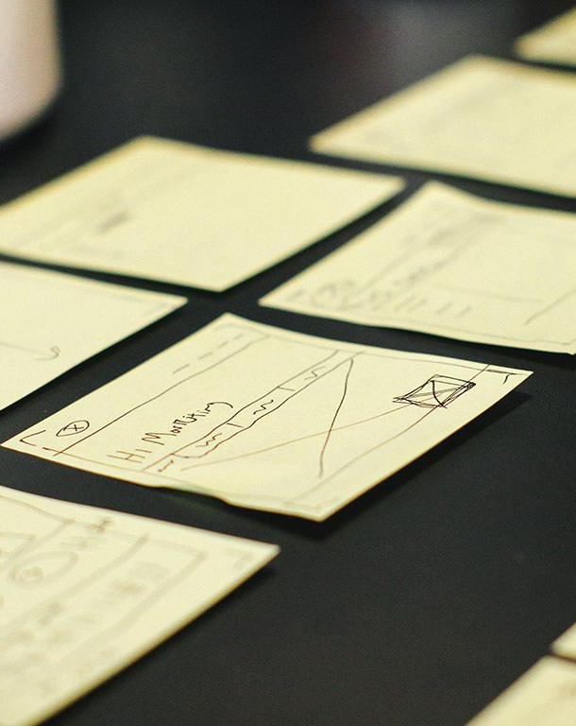
A PICTURE IS worth A THOUSAND WORDS
A complex idea can be conveyed with just a single still image, namely making it possible to absorb large amounts of data quickly.

Slide 19
USE CHARTS TO EXPLAIN YOUR ideas
White
Gray
Black

Slide 20
AND TABLES TO compare DATA
 | a | b | c
Yellow | 10 | 20 | 7
Blue | 30 | 15 | 10
Orange | 5 | 24 | 16

Slide 21

MAPS
our office

Slide 22
89,526,124
Whoa! That’s a big number, aren’t you proud?

Slide 23
89,526,124$
185,244 users
100%
That’s a lot of money
And a lot of users
Total success!

Slide 24
OUR PROCESS IS easy
First
Last
Second

Slide 25
LET’S REVIEW SOME concepts
Yellow
Is the color of gold, butter and ripe lemons. In the spectrum of visible light, yellow is found between green and orange.
Blue
Is the colour of the clear sky and the deep sea. It is located between violet and green on the optical spectrum.
Red
Is the color of blood, and because of this it has historically been associated with sacrifice, danger and courage.
Yellow
Is the color of gold, butter and ripe lemons. In the spectrum of visible light, yellow is found between green and orange.
Blue
Is the colour of the clear sky and the deep sea. It is located between violet and green on the optical spectrum.
Red
Is the color of blood, and because of this it has historically been associated with sacrifice, danger and courage.

Slide 26
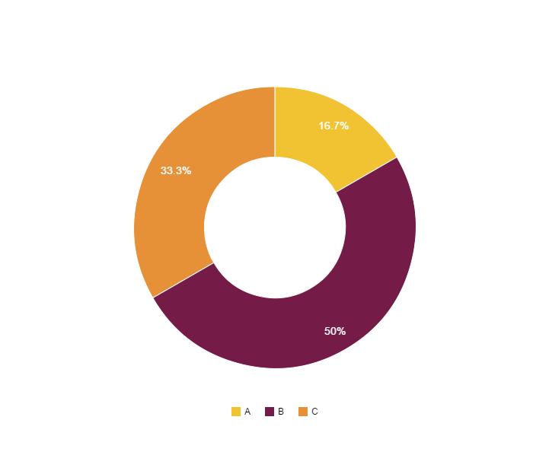
You can copy&paste graphs from Google Sheets

Slide 27
Place your screenshot here
ANDROID project
Show and explain your web, app or software projects using these gadget templates.

Slide 28
Place your screenshot here
DESKTOP project
Show and explain your web, app or software projects using these gadget templates.

Slide 29
thanks!
ANY QUESTIONS?
You can find me at:
@username
user@mail.me

Slide 30
SlidesCarnival icons are editable shapes.
This means that you can:
Resize them without losing quality.
Change fill color and opacity.
Isn’t that nice? :)
Examples:

Slide 31
😉
Now you can use any emoji as an icon!
And of course it resizes without losing quality and you can change the color.
How? Follow Google instructions https://twitter.com/googledocs/status/730087240156643328
✋👆👉👍👤👦👧👨👩👪💃🏃💑❤😂😉😋😒😭👶😸🐟🍒🍔💣📌📖🔨🎃🎈🎨🏈🏰🌏🔌🔑 and many more...

